Slide 1
Chem 108: Lab
Week 9
Sign in
Pick up handouts with a scantron
Sit at your lab station
i.e. where your lab drawer is located
Today’s Experiments: Chemical Reactions I & II
Chemical Reactions I: Fermentation, Synthesis of Ethanol
Chemical Reactions II: General Reactions
Both sets of procedures are to be completed today
Select a partner; Procedures pg. 62 & pp.44-45

Slide 2
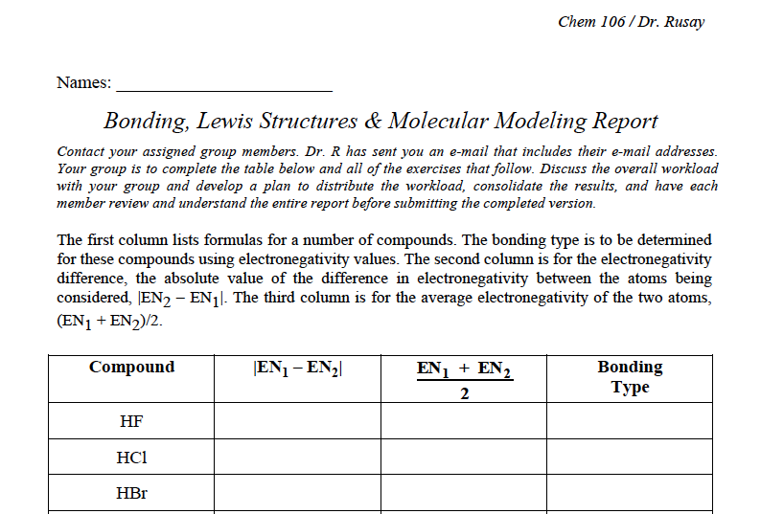
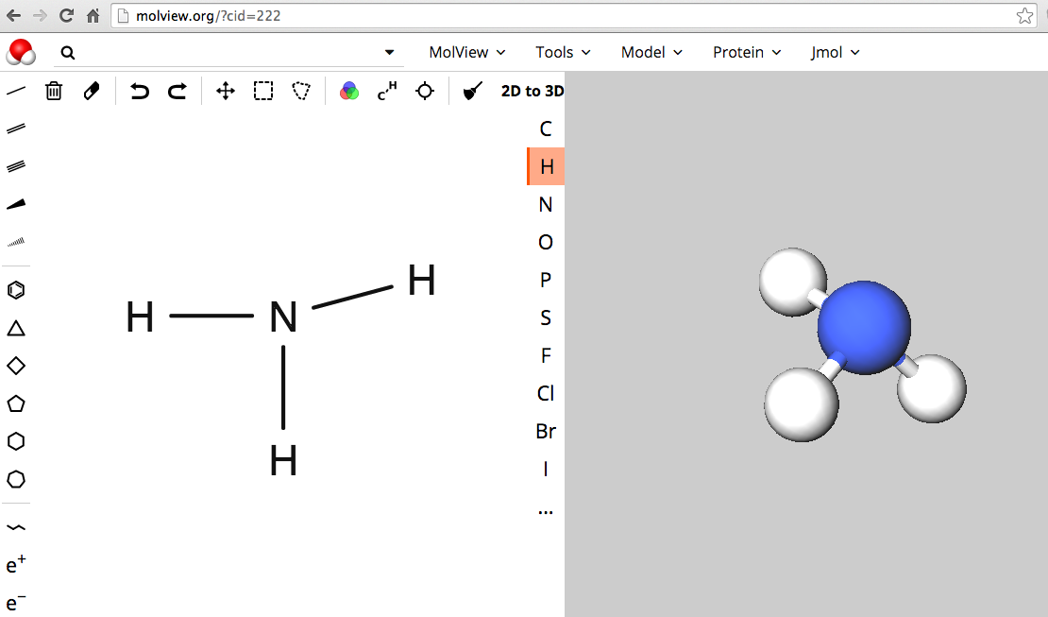
Molecular Modeling
(Individual or Collaborative)
Report Form (Replacement pages for Molecular Model Lab pp. 97-103)
http://chemconnections.org/general/chem108/Chemistry%20108%20Molecular%20Modeling%20Form%20Fall%202017.pdf
Turn-in individually or one per group
Due 27-Mar

Slide 3

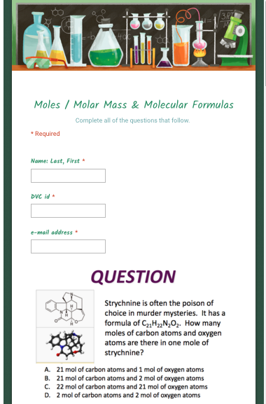
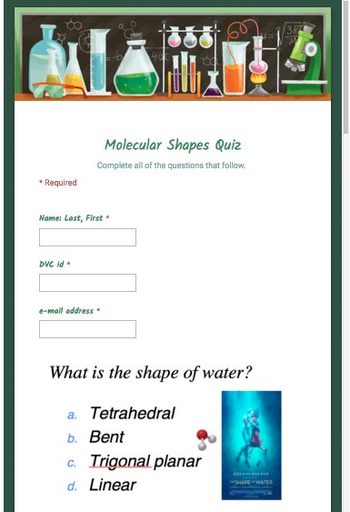
GCs
DUE
+7 Days
Post Labs DUE
RPT Day
20
QUIZZES
Moles / Molar Mass
&
Molecular Formulas
_________
and
Molecular Shapes
Both Quizzes
DUE:
29-Mar
Submit individually on-line
Refer to Calendar & Resources pages for links

Slide 4
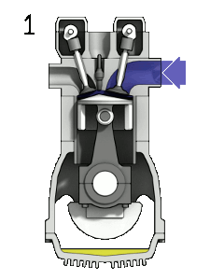
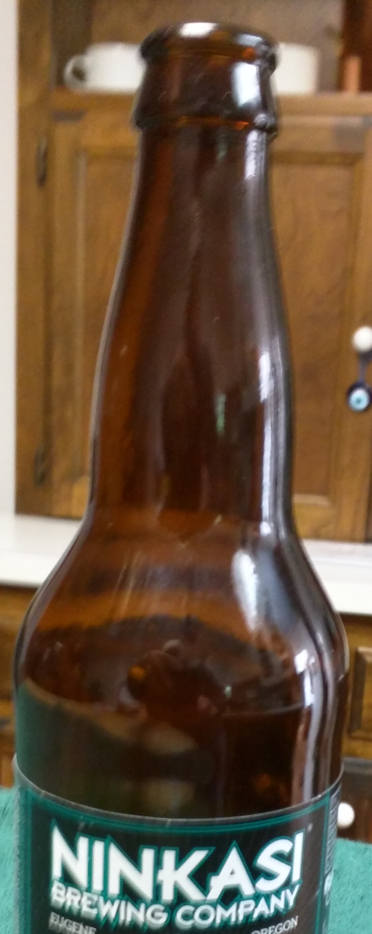
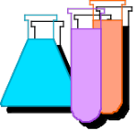
Chemical Reactions I & II
Select a partner; Lab Manual pp.44-45. & pg. 62
Do Today
Combination (Synthesis)
Decomposition
Single Displacement
Double Displacement
Biological Reactions: Enzyme Catalysts
Fermentation pg. 62
Combustion: Oxidation-Reduction
  pp. 44-45
_________________________
http://www.piney.com/BabNinkasi.html)
Notes:
A 3900-year-old clay tablet, which was found in Iraq between the Tigris and Euphrates rivers, had a Sumerian poem (http://www.piney.com/BabNinkasi.html) honoring Ninkasi, the patron goddess of brewing. It contains the oldest surviving beer recipe, describing the fermentation of the carbohydrates found in bread, bappir, made from barley, honey, dates and sweet aromatic herbs. The global availability of carbohydrates and native microbes (yeasts) has led to the production of many different types of beers, ales, wines, and fruit based alcoholic beverages in many countries throughout the world. [The bottle on the left was found in Eugene, Oregon, ……. But, it dates only to 2016.]

Slide 5

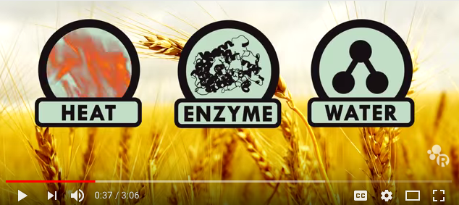
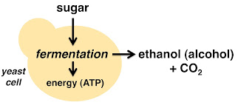
Chemical Reactions I (Biological Reaction)
Bakers’ yeast fermentation
zymase
https://www.youtube.com/watch?v=vW99JEaDApY
http://www.piney.com/BabNinkasi.html
Notes:
A 3900-year-old clay tablet, which was found in Iraq between the Tigris and Euphrates rivers, had a Sumerian poem (http://www.piney.com/BabNinkasi.html) honoring Ninkasi, the patron goddess of brewing. It contains the oldest surviving beer recipe, describing the fermentation of the carbohydrates found in bread, bappir, made from barley, honey, dates and sweet aromatic herbs. The global availability of carbohydrates and native microbes (yeasts) has led to the production of many different types of beers, ales, wines, and fruit based alcoholic beverages in many countries throughout the world. [The bottle on the left was found in Eugene, Oregon, ……. But, it dates only to 2016.]

Slide 6
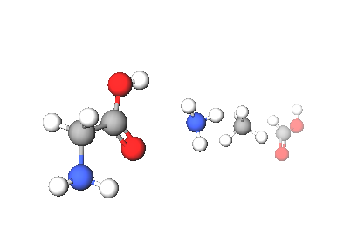
Amino Acids & Enzymes
Pre-set Legos of Chemical Biology & Bio-catalysis
Amino acids contain carbon, hydrogen, oxygen, and nitrogen, which resemble the following shapes & structural components
20 different amino acids are encoded in DNA providing a genetic code, an archive representing specific sequences of amino acids, which are linked together forming a specific protein.
Hundreds of amino acids are linked together through amide (peptide) bonds to form these proteins, some of which, enzymes, provide the catalytic basis for the chemistry of life.
There are less than 20,000 total proteins produced from humans’ entire DNA genome, each coded for by a specific gene in DNA’s ~3 billion genetic bases.
Notes:
http://www.jbc.org/content/262/2/549.short
http://pdb101.rcsb.org/motm/54
http://www.rcsb.org/pdb/explore/jmol.do?structureId=1CFJ&bionumber=1

Slide 7
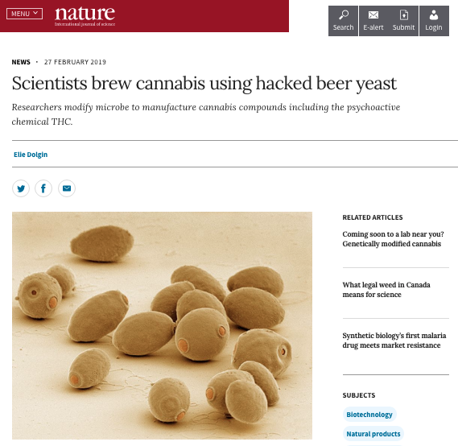
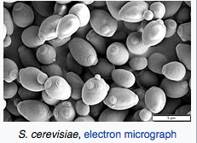
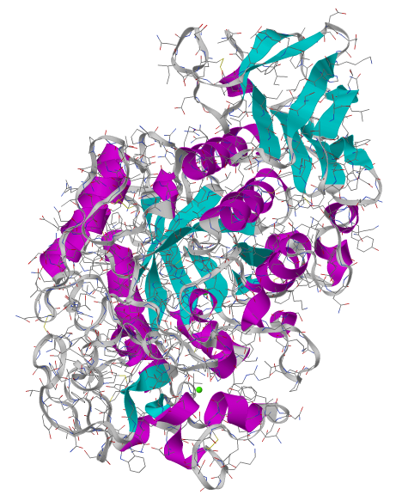
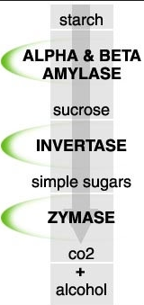
Amino Acids Proteins
Enzymes: Indispensible Biopolymers
amylase
Amylase, an enzyme, which catalyzes a key reaction in converting starches found in barley and other grains to simpler sugars, which another enzyme, zymase, ultimately converts to ethanol (alcohol).
Molar Mass: 44576 g/mol
Atoms: 3148
Amino Acid Residues: 396
Notes:
http://www.rcsb.org/pdb/explore/jmol.do?structureId=1CFJ&bionumber=1
http://pdb101.rcsb.org/motm/54
Global warming, barley & the price of beer going up.

Slide 8
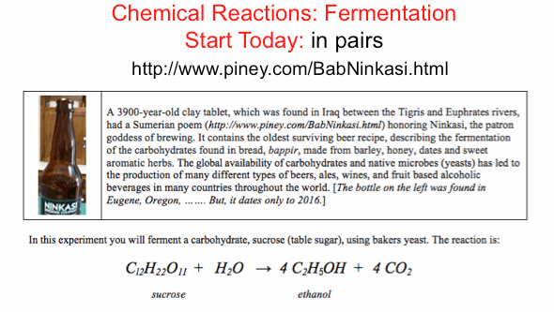
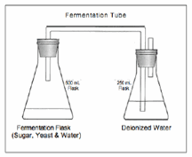
  pg. 62
zymase

Slide 9
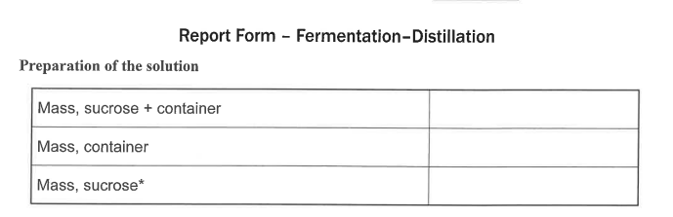
Chemical Reactions I
Biological Reactions: Enzyme Catalysts
  Fermentation
  pg. 62
  pg. 66
To Do Today
Have Dr. R. initial completed data pg. 66 before leaving lab
Notes:
A 3900-year-old clay tablet, which was found in Iraq between the Tigris and Euphrates rivers, had a Sumerian poem (http://www.piney.com/BabNinkasi.html) honoring Ninkasi, the patron goddess of brewing. It contains the oldest surviving beer recipe, describing the fermentation of the carbohydrates found in bread, bappir, made from barley, honey, dates and sweet aromatic herbs. The global availability of carbohydrates and native microbes (yeasts) has led to the production of many different types of beers, ales, wines, and fruit based alcoholic beverages in many countries throughout the world. [The bottle on the left was found in Eugene, Oregon, ……. But, it dates only to 2016.]

Slide 10
Chemical Reactions I & II
With your partner; Complete Lab Manual pp.44-45. & pg. 62
Do Today
Combination (Synthesis)
Decomposition
Single Displacement
Double Displacement
Combustion: Oxidation-Reduction
Biological Reactions: Enzyme Catalysts
  Fermentation pg. 62
  pp. 44-45
_________________________
http://www.piney.com/BabNinkasi.html)
Notes:
A 3900-year-old clay tablet, which was found in Iraq between the Tigris and Euphrates rivers, had a Sumerian poem (http://www.piney.com/BabNinkasi.html) honoring Ninkasi, the patron goddess of brewing. It contains the oldest surviving beer recipe, describing the fermentation of the carbohydrates found in bread, bappir, made from barley, honey, dates and sweet aromatic herbs. The global availability of carbohydrates and native microbes (yeasts) has led to the production of many different types of beers, ales, wines, and fruit based alcoholic beverages in many countries throughout the world. [The bottle on the left was found in Eugene, Oregon, ……. But, it dates only to 2016.]

Slide 11
Octane (Gas) Combustion Engine
Combustion: Oxidation-Reduction Reaction
2 C₈H_{18(l)}+ 25 O_{2(g)} 16 CO_{2(g)}+18 H₂O_{(l)} + energy
http://chemconnections.org/general/movies/4StrokeEngine_Ortho_3D_Small.gif
Notes:
<a title="By Zephyris (Own work) [CC BY-SA 3.0 (http://creativecommons.org/licenses/by-sa/3.0) or GFDL (http://www.gnu.org/copyleft/fdl.html)], via Wikimedia Commons" href="https://commons.wikimedia.org/wiki/File%3A4StrokeEngine_Ortho_3D_Small.gif"><img width="128" alt="4StrokeEngine Ortho 3D Small" src="https://upload.wikimedia.org/wikipedia/commons/d/dc/4StrokeEngine_Ortho_3D_Small.gif"/></a>

Slide 12
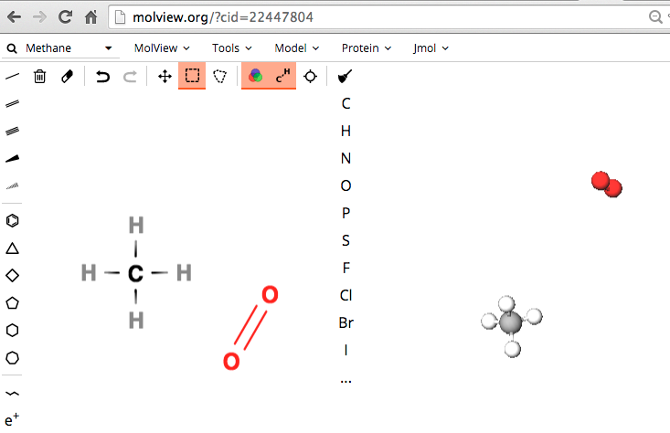

Molecular Shapes Lewis Structures
MolView: Visual On-line Molecular Modeling
http://molview.org
https://www.youtube.com/watch?v=cOJ3MUpDrfI&list=PLE7B4FAD08F1EBCE2&index=2
Bonding, Lewis Structures
Computational Experiments, Molecular Modeling

Slide 13
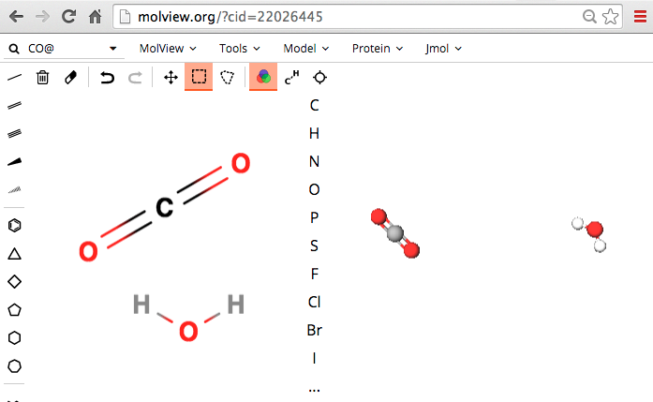
Molecular Shapes Lewis Structures
MolView: Visual On-line Molecular Modeling
http://molview.org
Bonding, Lewis Structures
Computational Experiments, Molecular Modeling

Slide 14




Combustion
1 CH_{4(g)}+ 2 O_{2(g)} 1 CO_{2(g)}+ 2 H₂O_{(g)} + energy
Bonding, Lewis Structures
Computational Experiments, Molecular Modeling
Notes:
<a title="By Zephyris (Own work) [CC BY-SA 3.0 (http://creativecommons.org/licenses/by-sa/3.0) or GFDL (http://www.gnu.org/copyleft/fdl.html)], via Wikimedia Commons" href="https://commons.wikimedia.org/wiki/File%3A4StrokeEngine_Ortho_3D_Small.gif"><img width="128" alt="4StrokeEngine Ortho 3D Small" src="https://upload.wikimedia.org/wikipedia/commons/d/dc/4StrokeEngine_Ortho_3D_Small.gif"/></a>

Slide 15
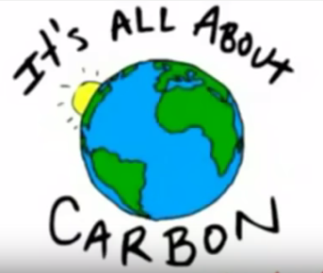
Combustion Products
Energy & CO₂
. 10/8/18
https://www.youtube.com/watch?v=Q9u8vM8YjeU&index=3&list=PLE7B4FAD08F1EBCE2

Slide 16
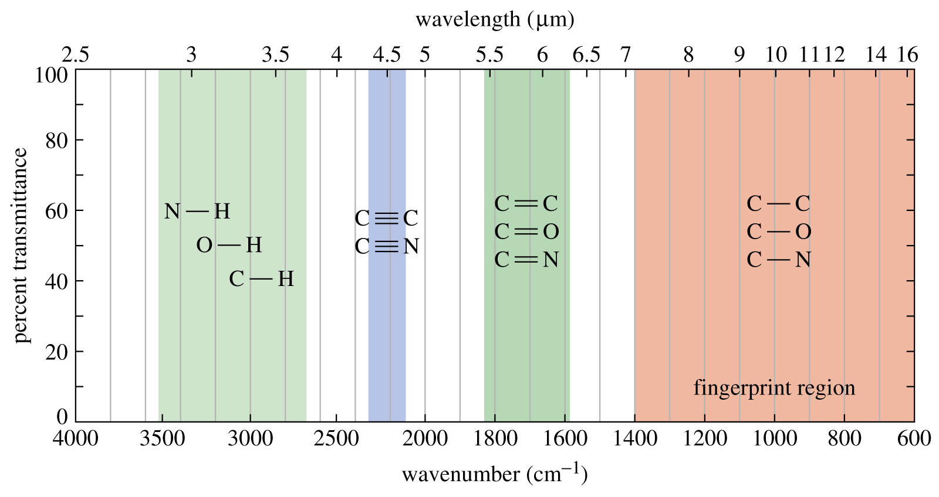
Infrared- Bond Absorbances
Infrared Energy
Electromagnetic Radiation
Notes:
Figure: 12-14-04UN
Caption:
The IR spectrum has distinct regions. The left of the spectrum shows the C-H, O-H, and N-H stretches. The triple bonds absorb around 2200 cm⁻¹ followed by the double bonds to the right at around 1700 cm⁻¹. The region below 1400 cm⁻¹ is called the fingerprint region.

Slide 17
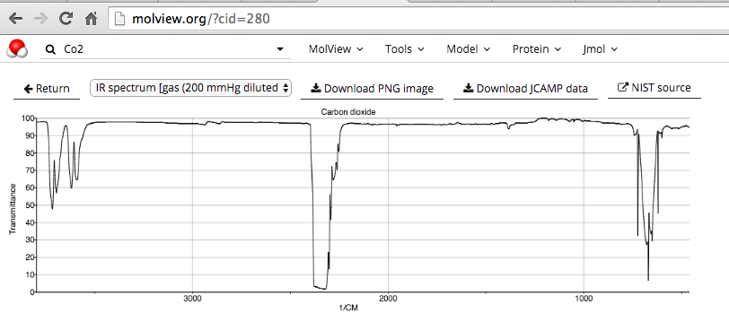

Infrared - Bond Absorbances
http://molview.org
Sun lamps = Infrared Energy
Notes:
Figure: 12-14-04UN
Caption:
The IR spectrum has distinct regions. The left of the spectrum shows the C-H, O-H, and N-H stretches. The triple bonds absorb around 2200 cm⁻¹ followed by the double bonds to the right at around 1700 cm⁻¹. The region below 1400 cm⁻¹ is called the fingerprint region.

Slide 18
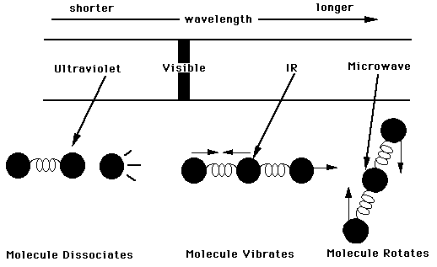
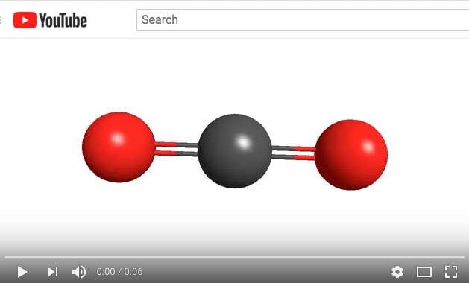
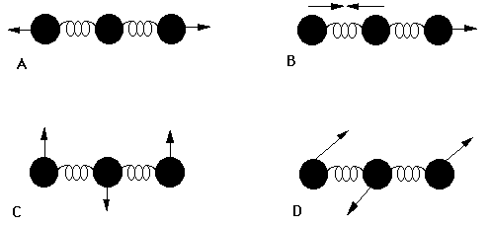
CO₂ Bond Vibrations - Absorbances
https://www.youtube.com/watch?v=W5gimZlFY6I
Notes:
Figure: 12-14-04UN
Caption:
The IR spectrum has distinct regions. The left of the spectrum shows the C-H, O-H, and N-H stretches. The triple bonds absorb around 2200 cm⁻¹ followed by the double bonds to the right at around 1700 cm⁻¹. The region below 1400 cm⁻¹ is called the fingerprint region.

Slide 19
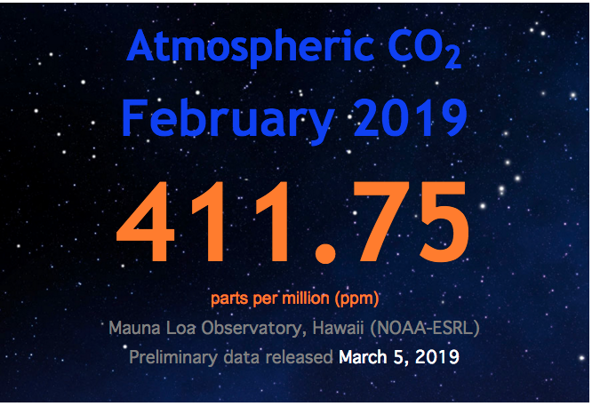
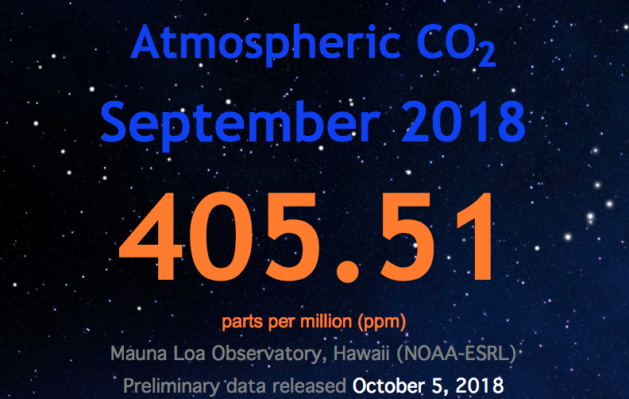
Infrared- Bond Absorbances
https://www.co2.earth/
Notes:
Figure: 12-14-04UN
Caption:
The IR spectrum has distinct regions. The left of the spectrum shows the C-H, O-H, and N-H stretches. The triple bonds absorb around 2200 cm⁻¹ followed by the double bonds to the right at around 1700 cm⁻¹. The region below 1400 cm⁻¹ is called the fingerprint region.

Slide 20
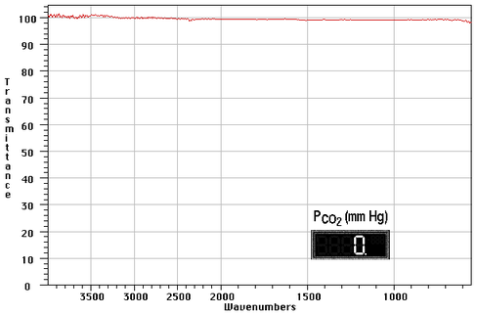
Infrared Spectra: CO₂ Concentration Effects
Nitrogen & Oxygen produce flat lines: 100% Transmission, 0 Absorbance
Turn in Global Warming scantron for quiz credit

Slide 21
CO₂ Concentration Effects
. 10/8/18
https://www.youtube.com/watch?v=EvphJO8VKlc&index=4&list=PLE7B4FAD08F1EBCE2

Slide 22

CO₂ Concentration Effects
Nitrogen & Oxygen produce flat lines: 100% Transmission, 0 Absorbance
March 15, 2019
https://twitter.com/i/events/1106352501077364736?cn=ZmxleGlibGVfcmVjcw%3D%3D&refsrc=email

Slide 23
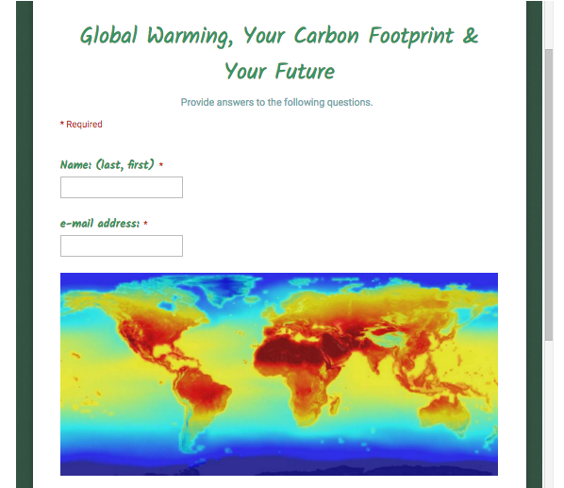
Global Warming
Survey Questions & Bonus Assignment
http://chemconnections.org/general/chem108/Global%20warming%20questions.pdf
http://chemconnections.org/general/chem108/Global%20warming%20%26%20Carbon%20Footprint.2017.pdf

Slide 24
Chemical Reactions II
Each partner is to keep individual records & reports pp. 46-52
To Do today:
Combination (Synthesis)
Decomposition
Single Displacement
Double Displacement
Combustion: Oxidation-Reduction
Biological Reactions: Enzyme Catalysts
_________________________
Have Dr. R. initial completed Lab Manual pp.46-47 plus pg. 66 before leaving lab
Notes:
A 3900-year-old clay tablet, which was found in Iraq between the Tigris and Euphrates rivers, had a Sumerian poem (http://www.piney.com/BabNinkasi.html) honoring Ninkasi, the patron goddess of brewing. It contains the oldest surviving beer recipe, describing the fermentation of the carbohydrates found in bread, bappir, made from barley, honey, dates and sweet aromatic herbs. The global availability of carbohydrates and native microbes (yeasts) has led to the production of many different types of beers, ales, wines, and fruit based alcoholic beverages in many countries throughout the world. [The bottle on the left was found in Eugene, Oregon, ……. But, it dates only to 2016.]

Slide 25
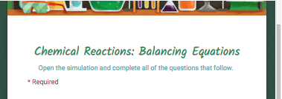
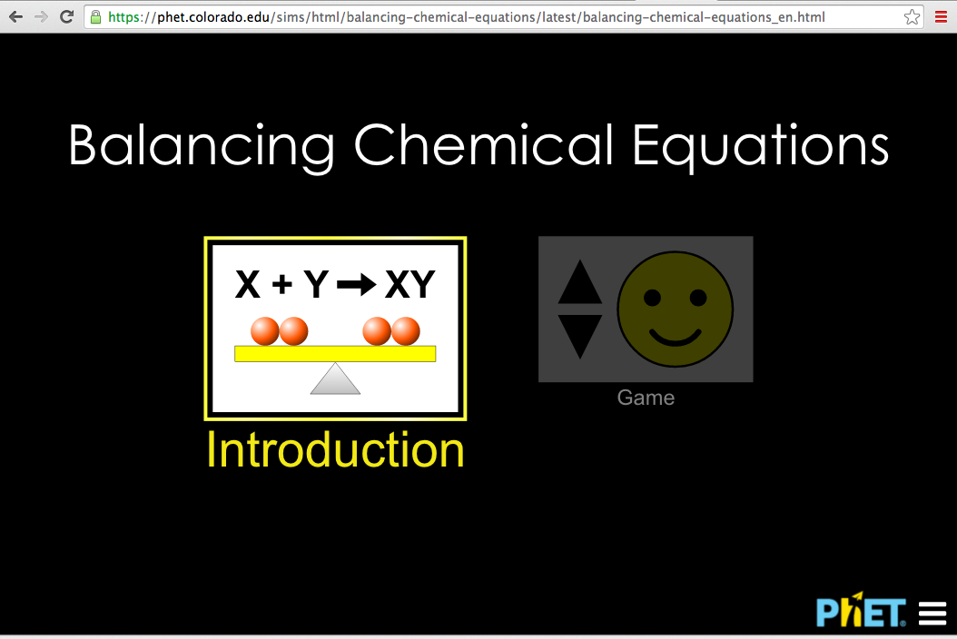
Post lab
https://phet.colorado.edu/sims/html/balancing-chemical-equations/latest/balancing-chemical-equations_en.html

